Slide 1
Project Update
09/24/2026
NEUR 4995

Slide 2
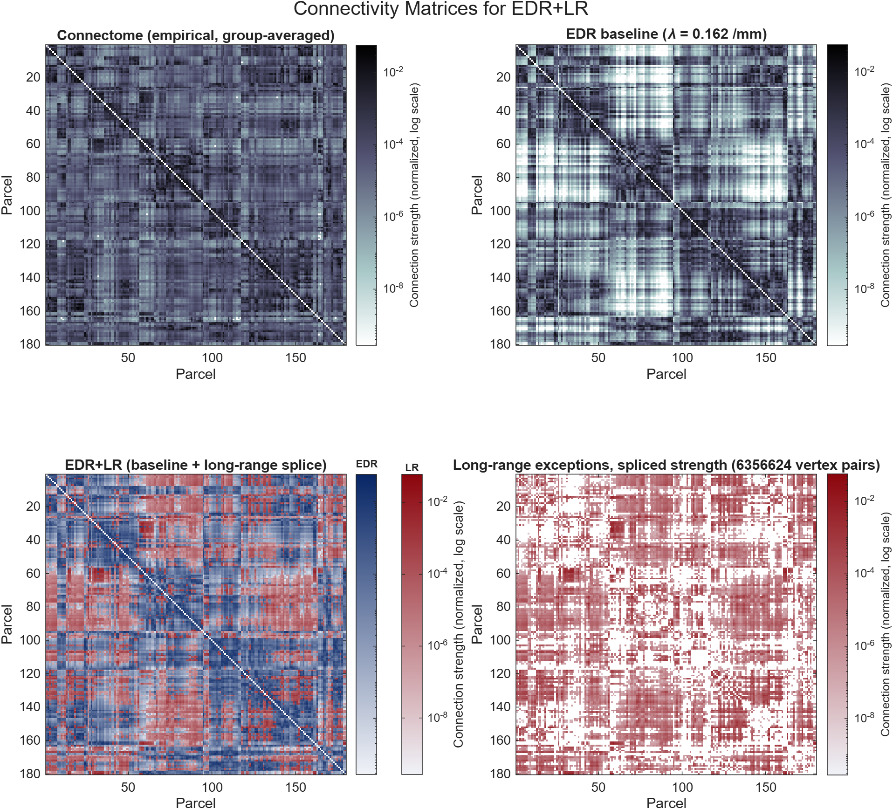
Structural Connectivity Matrices

Slide 3
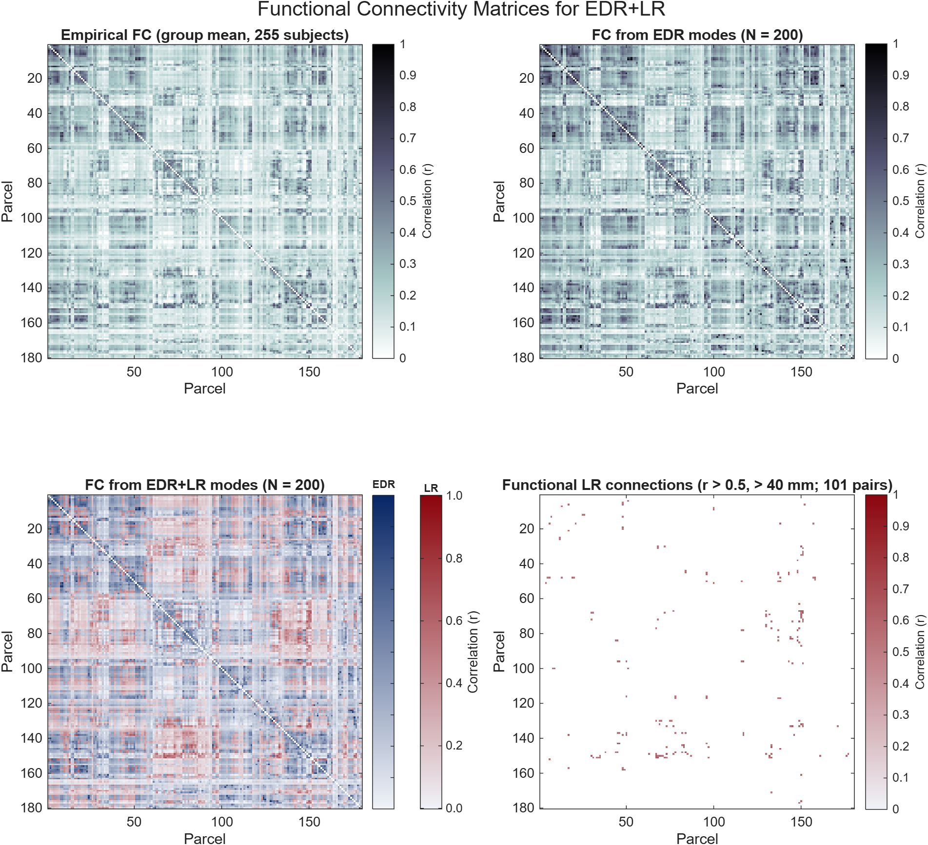
Functional Connectivity Matrices
Notes:
Structural and functional long-range connections only partly overlap. EDR+LR's advantage is in reconstructing functional long-range FC, not in matching it pair for pair.

Slide 4
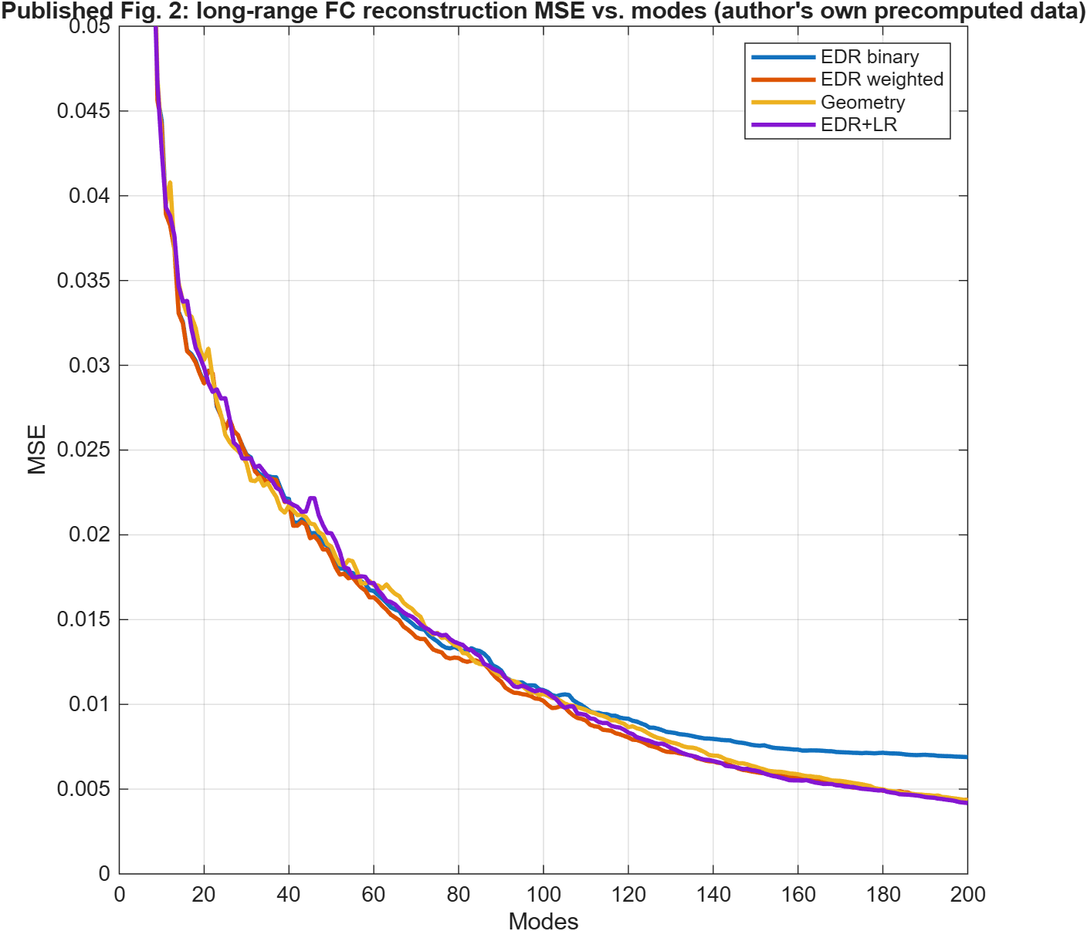
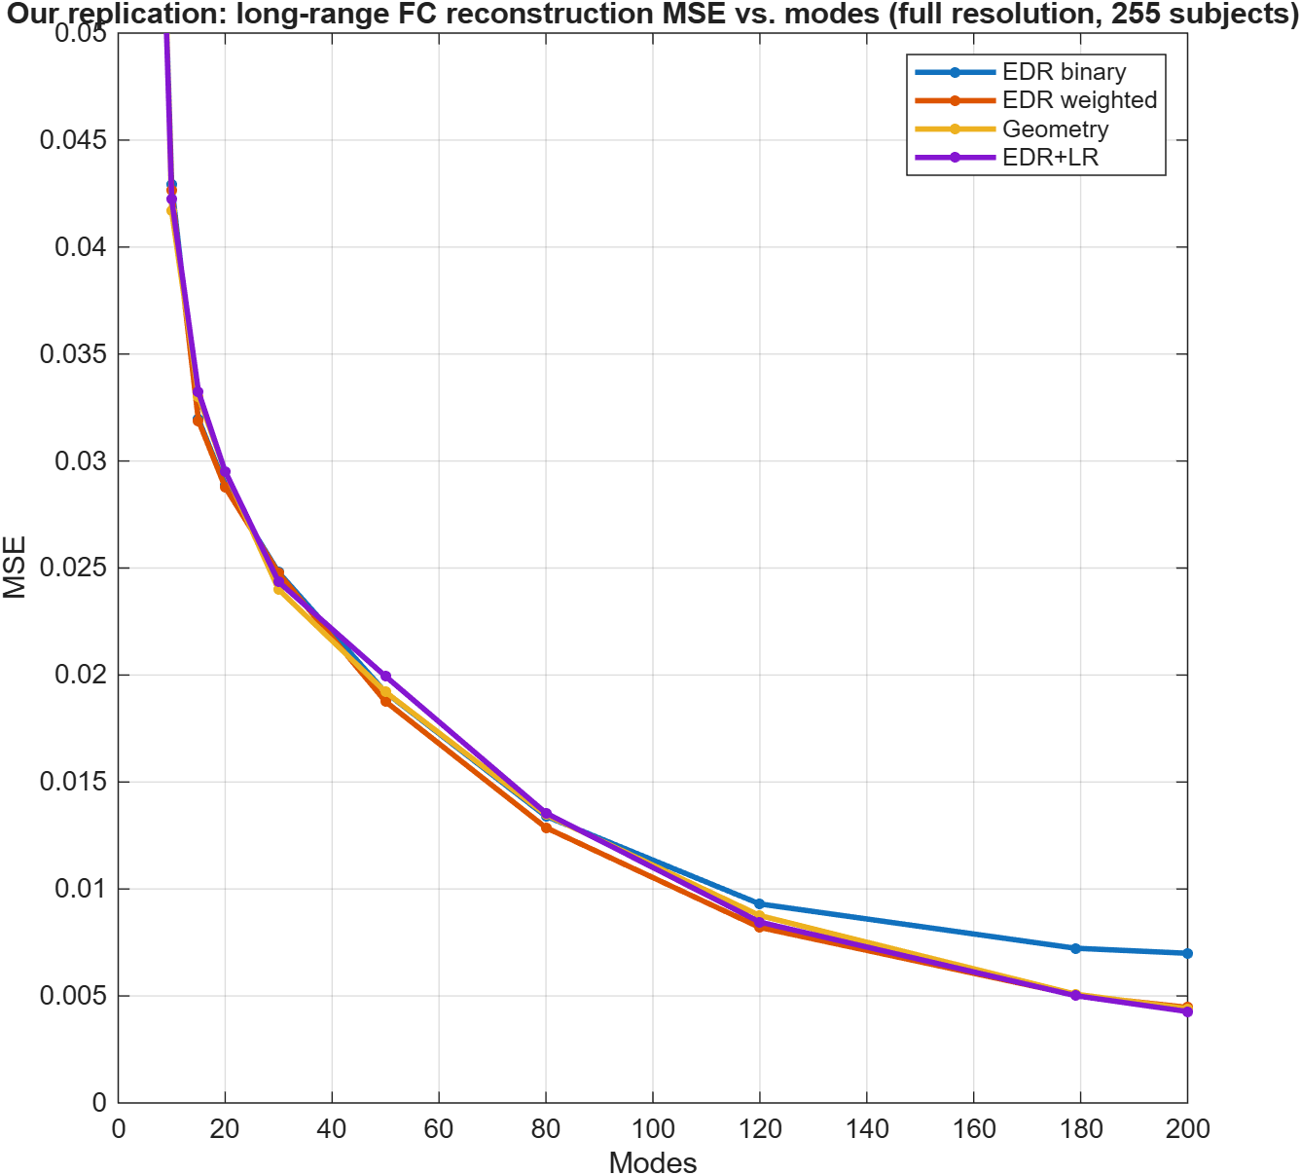
Long-Range FC Reconstruction
MSE of reconstructed long-range functional-connectivity edges vs. number of modes

Slide 5
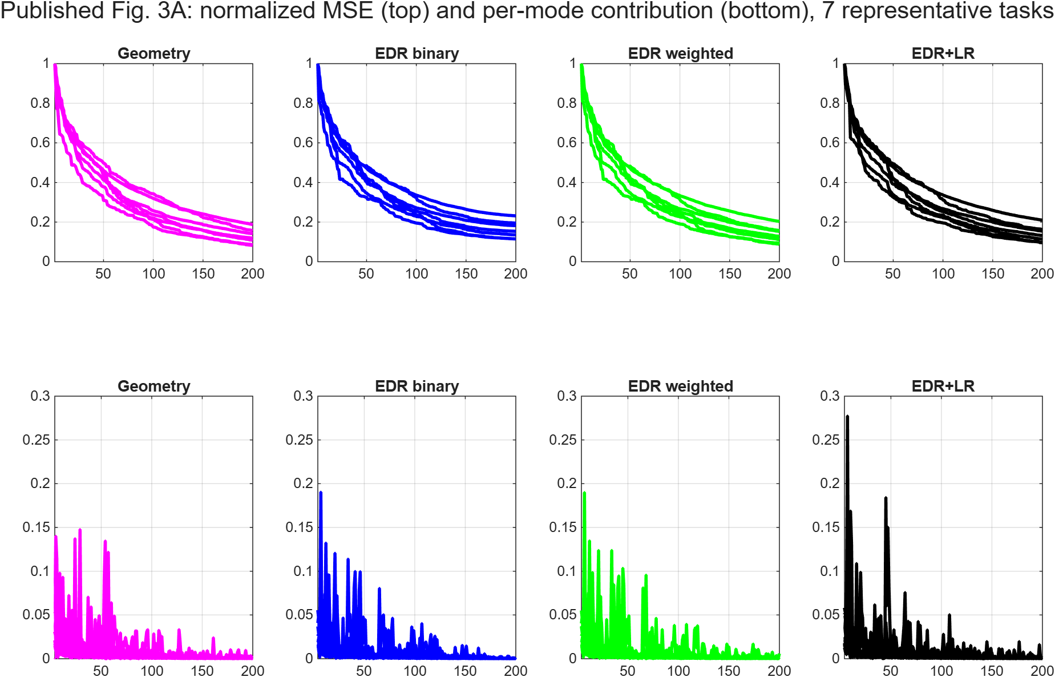
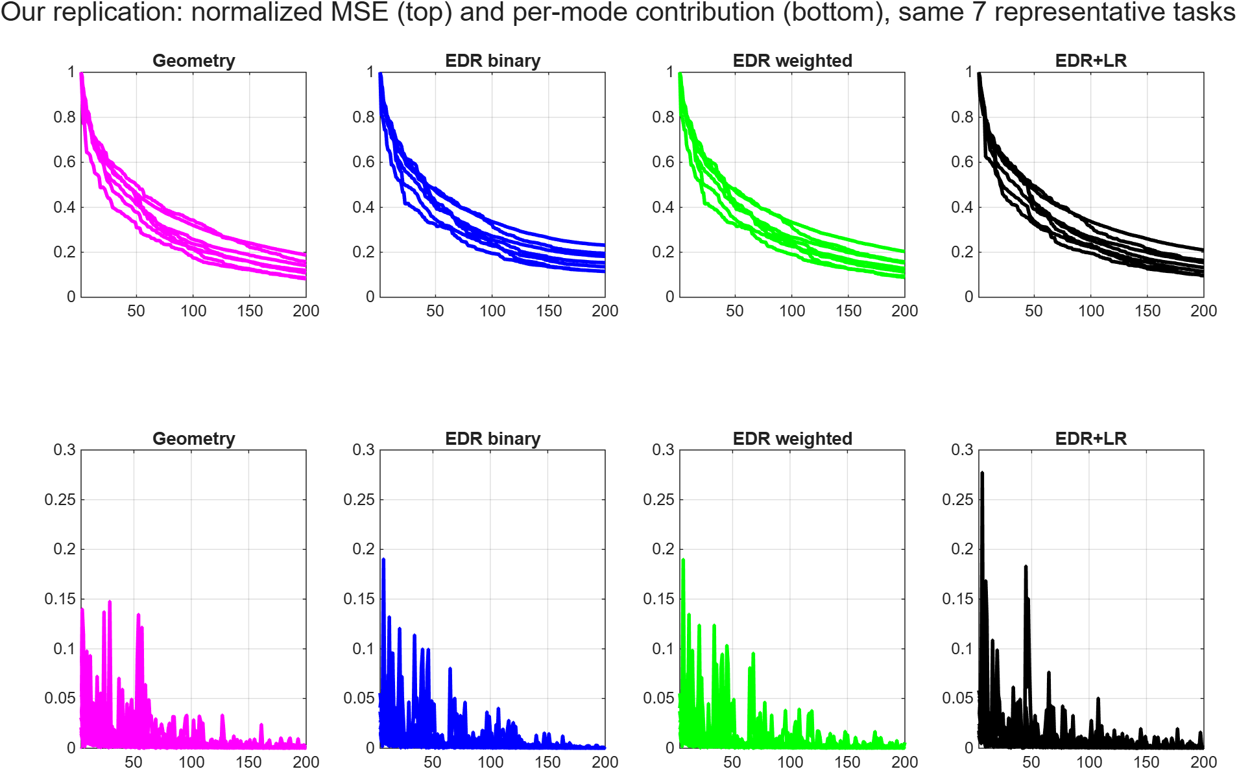
Task-Activity Reconstruction
Reconstruction accuracy vs. number of modes, by structural graph type
Paper — 7 representative tasks, authors' own code + own precomputed data
Our replication — same 7 tasks, same statistic, full vertex resolution
Notes:
Basically, how many modes are needed to reconstruct task activity?
Each of the four mode sets used to reconstruct brain activation maps for seven example tasks, one from each HCP task domain.
The top row shows the reconstruction error as more modes are added. The first, smoothest modes give the largest improvements, and after about 20 modes each extra mode adds very little (the "elbow"). So a small number of large-scale patterns captures most of the structure of task activity, which is why Panel B compares the mode sets using only the first 20 modes.

Slide 6
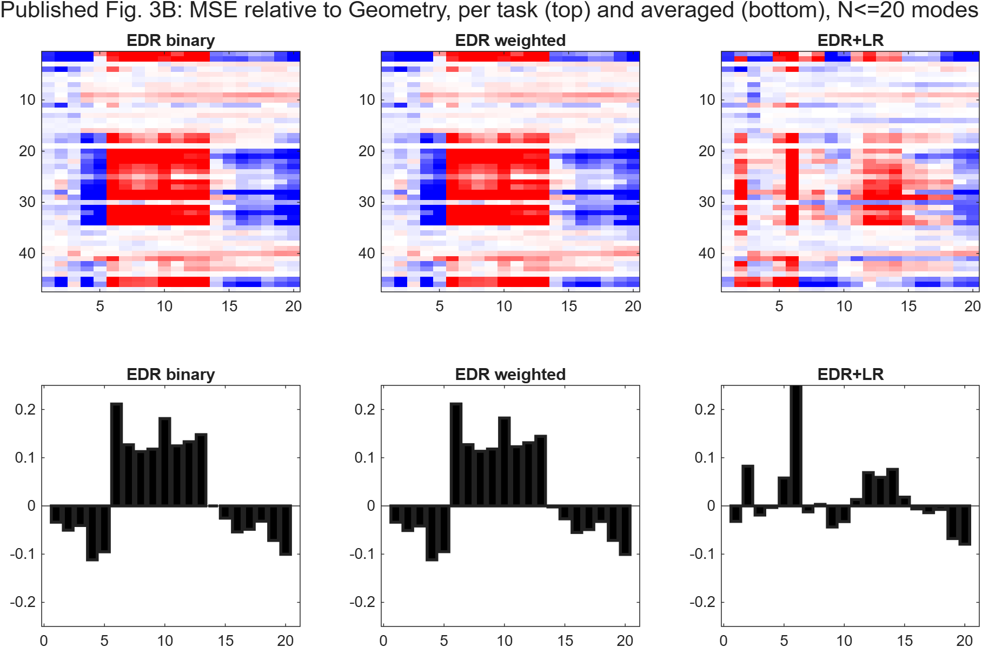
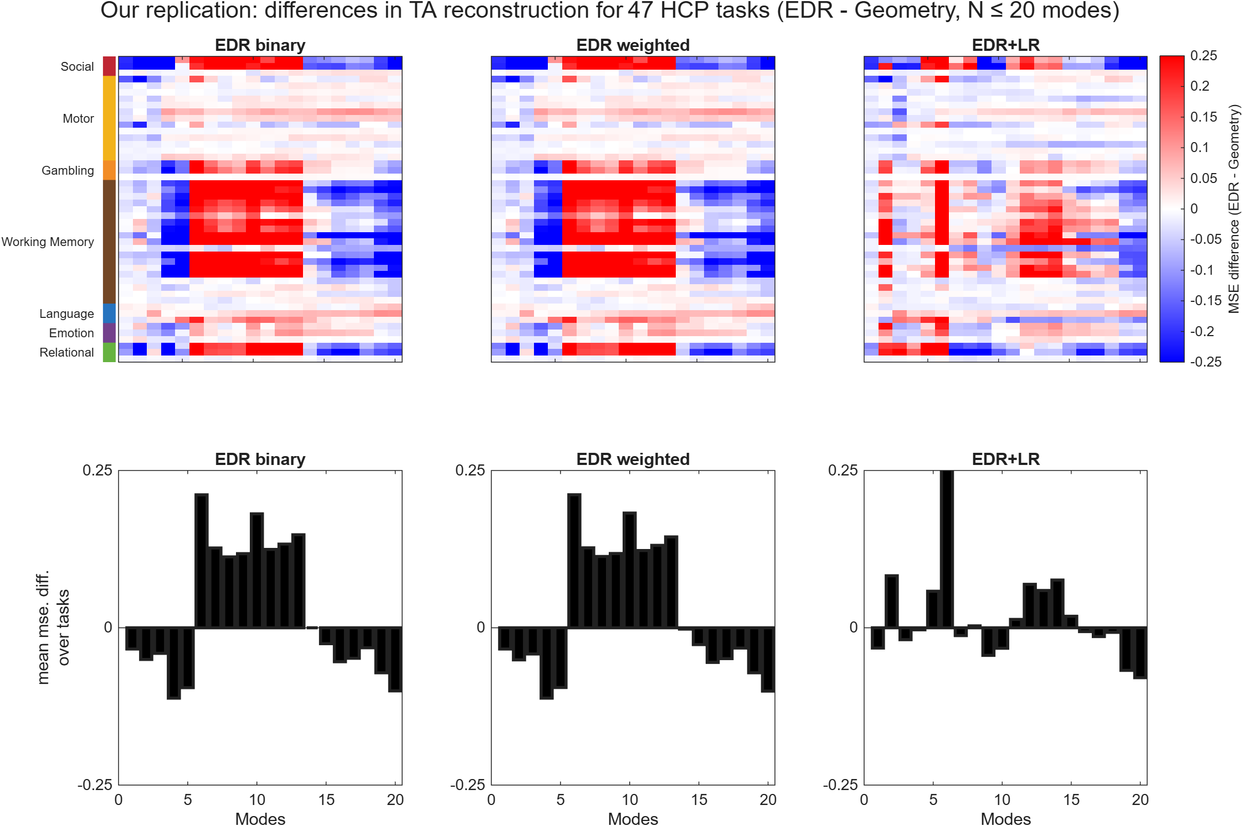
Per-Task Advantage over Geometry
MSE relative to Geometry, per task and averaged, N≤20 modes
Paper — authors' own code + own precomputed data
Our replication — same statistic, full vertex resolution
Notes:
This figure is Figure 3B of the article. It shows, task by task and mode by mode, whether the connectome-based modes or the geometry-based modes rebuild task activity better, and then averages that over all tasks.
Blue (negative) means the EDR modes rebuilt that task better than Geometry did.
Red (positive) means Geometry did better.
White means they contributing the same amount.
The bottom bar chart is the average of one column over all 47 tasks.

Slide 7
Per-Task Advantage over Geometry
Geometry-graph reconstruction MSE, N=20 modes, same 7 representative tasks
Task | Author's MSE | Our MSE | Difference
social_tom_random | 0.45921 | 0.45921 | +0.00%
motor_cue_avg | 0.79205 | 0.79205 | -0.00%
gambling_punish_reward | 0.20962 | 0.20962 | -0.00%
wm_2bk_0bk | 1.07045 | 1.07045 | -0.00%
language_math_story | 2.85734 | 2.85733 | -0.00%
emotion_faces_shapes | 0.76334 | 0.76334 | +0.00%
relational_match_rel | 0.27508 | 0.27508 | +0.00%
Comments.
Correlation across all 7 tasks × 200 modes = r = 0.99999996, RMS difference ≈ 1.5e-6 — our numbers and the authors', while remaining independently computed (not bit-identical, but that’s okay).

Slide 8
Per-Subject vs. Group-Averaged Reconstruction
Graph type | (group-avg before reconstruction) | FIXED (per-subject, then averaged) | Change
Geometry | 0.485 | 0.490 | +1.0%
EDR binary | 0.535 | 0.535 | +0.0%
EDR continuous | 0.512 | 0.525 | +2.6%
EDR+LR | 0.515 | 0.530 | +2.9%
When I was trying to reproduce the code, I initially found myself, averaging individual subject raw data, then using that for the reconstruction – as a single value. My replication was off but not by much.
Vohyzek et al. actually reconstructed the subject raw activity may first, then average the resulting MSE/correlation across subjects

Slide 9
Potential Next Step: Option 1. Integration
Build delay directly into the connectivity graph, then reuse it the same way we already use the EDR/Geometry eigenmodes.
Replicate the Original Delay Model Exactly
Vohryzek et al.'s entire framework reconstructs brain activity as a weighted sum of the real-valued eigenvectors (harmonic modes) of the EDR/EDR+LR graph Laplacian. Budzinski et al. (2023) instead define a complex-valued coupling matrix, W = A · exp(-iωτ), where τ is the conduction delay (distance / conduction speed).
The Idea. compute the eigenvectors of this complex delay matrix, using the reported parameters (oscillator frequency, coupling strength, conduction speed) and use them as the reconstruction basis in exactly the same way, in place of the real EDR/EDR+LR eigenvectors already used.
This would it stays inside Vohryzek's own linear-reconstruction framework instead of switching to a different evaluation paradigm — the most direct test of whether baking delay into the basis itself changes reconstruction behavior.
What I’m looking for: compare reconstruction accuracy using the delay matrix's complex eigenvectors against the real EDR+LR eigenvectors — does incorporating delay into the basis change how many modes are needed, or how well long-range FC / task activity is reconstructed?

Slide 10
Other options for Option 1
Xie et al. (2021) – Adding delay turns the graph into a complex-valued network. Its modes predict real brain networks better than the standard, delay-free version
Aqil et al. (2020) – Shows static eigenmode bases can be extended into full dynamical modes (“graph neural fields”). WE could use this as a template potentially, if we don’t get sufficient results.
Kringebach et al. (2026) – Argues connectome harmonics and delay/complex harmonics are mathematically the same underlying operator, just tuned differently. Supports the idea of delay as an extension of the framework.

Slide 11
Alternative Paths
If in case option one of integration doesn’t work, these are options that I think we could try
Analytic linear-stability via existing eigenmodes — linearize the delayed Kuramoto model around its phase-locked state and diagonalize by the same graph-Laplacian eigenmodes our EDR/EDR+LR pipeline already computes, giving closed-form stability predictions instead of full simulation. (Ameli, Mahdavi, Zarei & Shahbazi 2025, arXiv:2502.00884)
Add inertia (second-order delayed Kuramoto) — extend the delayed Kuramoto model with an inertia term; delay and inertia jointly produce multistability, traveling waves, and chimera states, analyzed via the same eigenmode machinery. (Mahdavi, Zarei, Hövel & Shahbazi 2025, arXiv:2512.16640)
Discrete delayed phase-resetting — model regions as higher-dimensional “clocks” instantaneously phase-reset by delayed signals from structurally connected regions, using EDR+LR as the directed network — basically a event-driven alternative to continuous delayed coupling. (Brennan & Grindrod 2023, Brain Multiphysics 4:100070)

Slide 12
Alternative Paths
d. Data-driven delay via time-lag embedding — Essentially fitting a delay-coordinate linear surrogate (Hankel-DMD/HAVOK) directly to empirical or simulated data, letting the data determine delay/memory depth instead of assuming it from distance and conduction speed. (Pan & Duraisamy 2020, arXiv:1902.05198; related: Panahi et al. 2021, arXiv:2112.12147)
e. Network spectral dimension as an alternative lens — long-range connections like EDR+LR reshape synchronization via the network's spectral dimension, producing frustrated transitions even without explicit delay — Maybe see how much of the delay effect this alone explains. (Ódor, Deng & Kelling 2024, Entropy 26:1074)
f. Multi-delay decomposition— splitting one large delay into multiple delayed-feedback terms at different lags provably extends the maximum stabilizable delay; could inspire distinct delay terms for short- vs. long-range EDR+LR edges. (Trinh et al. 2026, arXiv:2604.17434)

Slide 13
Option 2. Delay as a Feature: Simulation
Simulate brain activity with delay included, then test whether it matches real brain connectivity better than a no-delay simulation.
Cabral et al. (2011) —Delay-coupled simulation matches real resting-state connectivity best at ~6 m/s conduction speed.
Deco et al. (2009) —best speed ~1–2 m/s. Close to our own result (2.5–3.0 m/s).
Cabral et al. (2022) — Delay produces "metastability" — clusters of brain regions syncing while the whole network stays flexible. This is specifically what produces realistic connectivity patterns.
Koller et al. (2024) — Delay is required to get the correct direction of brain waves, not just the right connectivity strength — a stronger test than correlation alone.
Torres et al. (2025) — Explains why the "best" delay speed changes with brain-map resolution. Resolves a puzzle in our own earlier results.

Slide 14
References
Ameli, S., Mahdavi, E., Zarei, M., & Shahbazi, F. (2025). Synchronization of the time-delayed Kuramoto model in a regular network. arXiv:2502.00884.
Aqil, M., Atasoy, S., Kringelbach, M. L., & Hindriks, R. (2020). Graph neural fields: A framework for spatiotemporal dynamical models on the human connectome. bioRxiv. https://doi.org/10.1101/2020.09.08.287110
Brennan, M., & Grindrod, P. (2023). Generalised Kuramoto models with time-delayed phase-resetting for k-dimensional clocks. Brain Multiphysics, 4, 100070. https://doi.org/10.1016/j.brain.2023.100070
Budzinski, R. C., Nguyen, T. T., Benigno, G. B., Đoàn, J., Mináč, J., Sejnowski, T. J., & Muller, L. E. (2023). Analytical prediction of specific spatiotemporal patterns in nonlinear oscillator networks with distance-dependent time delays. Physical Review Research, 5, 013159. https://doi.org/10.1103/PhysRevResearch.5.013159
Cabral, J., Castaldo, F., Vohryzek, J., Litvak, V., Bick, C., Lambiotte, R., Friston, K., Kringelbach, M. L., & Deco, G. (2022). Metastable oscillatory modes emerge from synchronization in the brain spacetime connectome. Communications Physics, 5. https://doi.org/10.1038/s42005-022-00950-y
Cabral, J., Hugues, E., Sporns, O., & Deco, G. (2011). Role of local network oscillations in resting-state functional connectivity. NeuroImage, 57, 130–139. https://doi.org/10.1016/j.neuroimage.2011.04.010
Deco, G., Jirsa, V., McIntosh, A. R., Sporns, O., & Kötter, R. (2009). Key role of coupling, delay, and noise in resting brain fluctuations. Proceedings of the National Academy of Sciences, 106(25), 10302–10307. https://doi.org/10.1073/pnas.0901831106
Koller, D. P., Schirner, M., & Ritter, P. (2024). Human connectome topology directs cortical traveling waves and shapes frequency gradients. Nature Communications, 15, 3570. https://doi.org/10.1038/s41467-024-47860-x
Kringelbach, M. L., & Deco, G. (2026). One operator to rule them all: Unifying connectome harmonics, turbulence and complex harmonics in brain dynamics. bioRxiv. https://doi.org/10.64898/2026.06.05.730423
Mahdavi, E., Zarei, M., Hövel, P., & Shahbazi, F. (2025). Time-delayed dynamics in regular Kuramoto networks with inertia: Multistability, traveling waves, chimera states, and transitions to seizure-like activity. arXiv:2512.16640.

Slide 15
References (continued)
Ódor, G., Deng, S., & Kelling, J. (2024). Frustrated synchronization of the Kuramoto model on complex networks. Entropy, 26(12), 1074. https://doi.org/10.3390/e26121074
Pan, S., & Duraisamy, K. (2020). On the structure of time-delay embedding in linear models of non-linear dynamical systems. arXiv:1902.05198.
Pang, J. C., Aquino, K. M., Oldehinkel, M., Robinson, P. A., Fulcher, B. D., Breakspear, M., & Fornito, A. (2023). Geometric constraints on human brain function. Nature, 618, 566–574. https://doi.org/10.1038/s41586-023-06098-1
Ramezanian-Panahi, M., Abrevaya, G., Gagnon-Audet, J.-C., Voleti, V., Rish, I., & Dumas, G. (2021). Generative models of brain dynamics: A review. arXiv:2112.12147.
Torres, F. A., Weinstein, A., Cortes, J. M., & El-Deredy, W. (2025). Intrinsic resonance depends on network size of coupled-delayed interacting oscillators. arXiv:2511.14065.
Trinh, H., Nam, P. T., & Nguyen, T. N. (2026). Time-delay compensators for linear systems with delayed output measurements. arXiv:2604.17434.
Van Essen, D. C., Smith, S. M., Barch, D. M., Behrens, T. E. J., Yacoub, E., Ugurbil, K., & WU-Minn HCP Consortium. (2013). The WU-Minn Human Connectome Project: An overview. NeuroImage, 80, 62–79. https://doi.org/10.1016/j.neuroimage.2013.05.041
Vohryzek, J., Sanz-Perl, Y., Kringelbach, M. L., & Deco, G. (2025). Human brain dynamics are shaped by rare long-range connections over and above cortical geometry. Proceedings of the National Academy of Sciences, 122(1), e2415102122. https://doi.org/10.1073/pnas.2415102122
Xie, X., Cai, C., Damasceno, P. F., Nagarajan, S. S., & Raj, A. (2021). Emergence of canonical functional networks from the structural connectome. NeuroImage, 237, 118190. https://doi.org/10.1016/j.neuroimage.2021.118190

